Slide 1
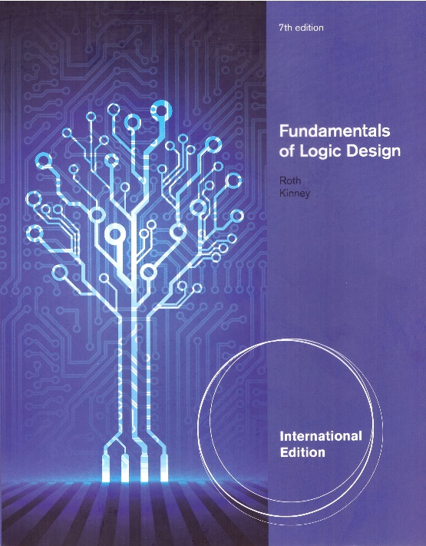
Unit 6
QUINE-McCLUSKEY METHOD
This chapter in the book includes:
Objectives
Study Guide
6.1 Determination of Prime Implicants
6.2 The Prime Implicant Chart
6.3 Petrick’s Method
6.4 Simplification of Incompletely Specified Functions
6.5 Simplification Using Map-Entered Variables
6.6 Conclusion
Programmed Exercises
Problems

Slide 2
Objectives
1. Find the prime implicants of a function by using the Quine-McCluskey method.
2. Define prime implicants and essential prime implicants
3. Given the prime implicants, find the essential prime implicants and
a minimum sum-of-products expression for a function, using a prime implicant
chart and using Petrick method
4. Minimize an incompletely specified function, using the Quine-McCluskey method
5. Find a minimum sum-of-products expression for a function,
using the method of map-entered variables

Slide 3
6.1 Determination of Prime Implicants
The minterms are represented in binary notation and
combined using
The binary notation and its algebraic equivalent
AB’CD’ + AB’CD = AB’C
1010 + 1011 = 101-
X Y X Y’ X
ABCD’ + AB’CD
1110 + 1011
-, the dash indicates a missing variable
Good Neighbors
will not combine

Slide 4
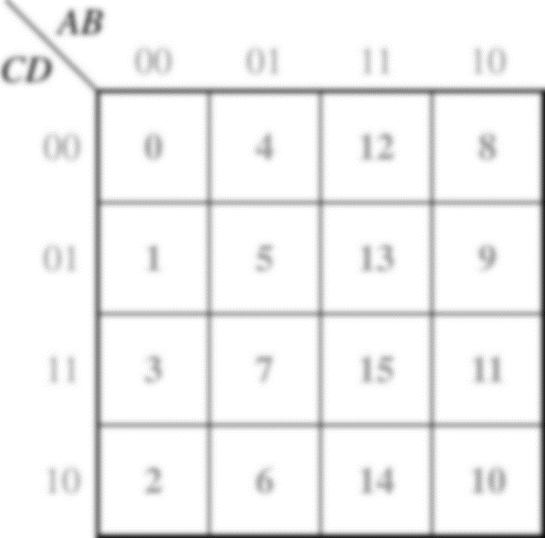
6.1 Determination of Prime Implicants
Example
The binary minterms are sorted into groups
Group # : number of 1s
1
1
1
1
1
1
1
1
1
1

Slide 5
6.1 Determination of Prime Implicants
Determination of Prime Implicants (Table 6-1)
Column Ⅰ Column Ⅱ Column Ⅲ

Slide 6
6.1 Determination of Prime Implicants
Determination of Prime Implicants (Table 6-1)
Column Ⅰ Column Ⅱ Column Ⅲ

Slide 7
6.1 Determination of Prime Implicants
The function is equal to the sum of its prime implicants
(1,5) (5,7) (6,7) (0,1,8,9) (0,2,8,10) (2,6,10,14)
Using the consensus theorem to eliminate redundant terms yields
Definition: Given a function F of n variables, a product term P is an implicant of F iff for every combination of values of the n variables for which P=1, F is also equal to 1
Definition: A Prime implicants of a function F is a product term implicant which is no longer an implicant if any literal is deleted from it
Exercise this function to find PI, EPI and solution with K-map (slide #4)

Slide 8

6.2 The Prime Implicant Chart
Prime Implicant Chart (Table 6-2)
Sniper’s order
Essential Prime Implicant :
⊗
⊗
0
1
2
5
6
7
8
9
10
14
0,1,8,9
b’c’
X
X
X
X
0,2,8,10
b’d’
X
X
X
X
2,6,10,14
cd’
X
X
X
X
1,5
a’c’d
X
X
5,7
a’bd
X
X
6,7
a’bc
X
X
Remaining cover-DO NOT leave any lonesome crying wolf

Slide 9
6.2 The Prime Implicant Chart
Prime Implicant Chart (Table 6-2)
Sniper’s order
Essential Prime Implicant :
⊗
⊗
0
1
2
5
6
7
8
9
10
14
0,1,8,9
b’c’
X
X
X
X
0,2,8,10
b’d’
X
X
X
X
2,6,10,14
cd’
X
X
X
X
1,5
a’c’d
X
X
5,7
a’bd
X
X
6,7
a’bc
X
X
Remaining cover-DO NOT leave any lonesome crying wolf

Slide 10
6.2 The Prime Implicant Chart
The resulting chart (Table 6-3)
⊗
0
1
2
5
6
7
8
9
10
14
0,1,8,9
b’c’
X
X
X
⊗
0,2,8,10
b’d’
X
X
X
X
2,6,10,14
cd’
X
X
X
⊗
1,5
a’c’d
X
X
5,7
a’bd
X
X
6,7
a’bc
X
X
The resulting minimum sum of products is

Slide 11
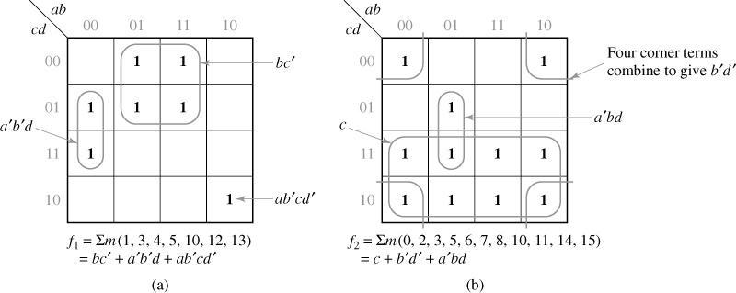
6.2 The Prime Implicant Chart
Exercise with 4-variables
Exercise with 5-variables
F
(
A
,
B
,
C
,
D
,
E
)
=
∑
m
(
0
,
1
,
4
,
5
,
13
,
15
,
20
,
21
,
22
,
23
,
24
,
26
,
28
,
30
,
31
)

Slide 12
6.2 The Prime Implicant Chart
Example: cyclic prime implicant chart
(two more X’s in every column in chart)
Derivation of prime implicants
0
000
(0,1)
00-
1
001
(0,2)
0-0
2
010
(1,5)
-01
5
101
(2,6)
-10
6
110
(5,7)
1-1
7
111
(6,7)
11-

Slide 13
6.2 The Prime Implicant Chart
The resulting prime implicant chart (Table 6-4)
⊗
0
1
2
5
6
7
①
->
(0,1)
a’b’
X
X
(0,2)
a’c’
X
X
(1,5)
b’c
X
X
②
->
(2,6)
bc’
X
X
③
->
(5,7)
ac
X
X
(6,7)
ab
X
X
One solution

Slide 14
6.2 The Prime Implicant Chart
Again starting with the other prime implicant that covers column 0. The resulting table (Table 6-5)
0
1
2
5
6
7
P₁
(0,1)
a’b’
X
X
P₂
(0,2)
a’c’
X
X
P₃
(1,5)
b’c
X
X
P₄
(2,6)
bc’
X
X
P₅
(5,7)
ac
X
X
P₆
(6,7)
ab
X
X
Finish the solution

Slide 15
6.3 Petrick’s Method
A technique for determining all minimum SOP solutions from a PI chart
0
1
2
5
6
7
P₁
(0,1)
a’b’
X
X
P₂
(0,2)
a’c’
X
X
P₃
(1,5)
b’c
X
X
P₄
(2,6)
bc’
X
X
P₅
(5,7)
ac
X
X
P₆
(6,7)
ab
X
X
Because we must cover all of the minterms, the following function must be true
minterm0
minterm1

Slide 16
6.3 Petrick’s Method
Reduce P to a minimum SOP
First, we multiply out using (X+Y)(X+Z) = X+YZ and the distributive law
Use X+XY=X to eliminate redundant terms from P
Choose P₁,P₄,P₅ or P₂,P₃,P₆ for minimum solution
Less important
or
Notes:
(P1 + P2) (P1 + P3) = P1P1 + P1P2 + P1P3 + P2P3 = P1 (1 + P2 + P3) + P2P3 = P1 + P2P3
P2P3P6 + P2P3PP5P6 + P1P2P3P6 + P2P3P4P6 = P2P3P6 (1 + P5 + P1 + P4) = P2P3P6

